Slide 1
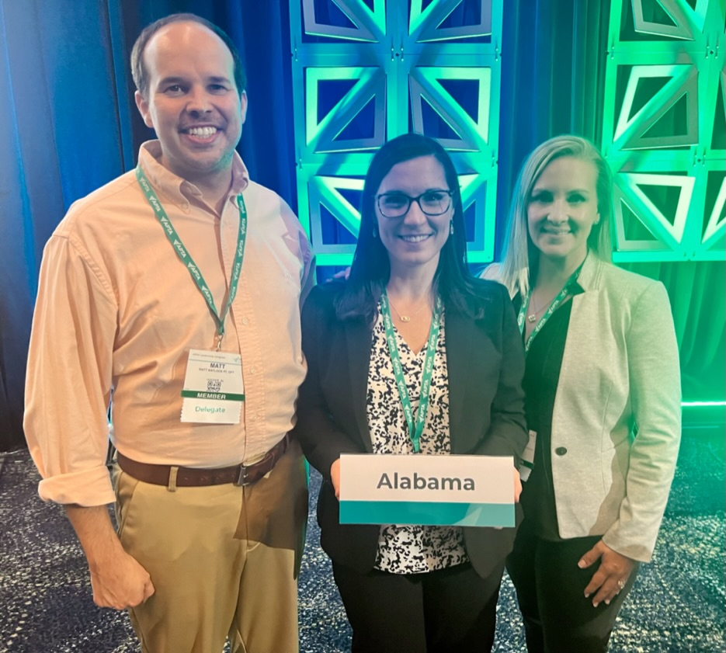
2024 APTA Alabama Delegates
Andrea Bowens (Chief Delegate)
Matt Matlock
Lesley Parrish
Notes:
Lost one delegate this year due to the apportionment of delegates based on chapter membership

Slide 2
APTA House of Delegates Motions
In-Person House of Delegates took place in Kansas City, MO on July 21-22
24 motions presented – 17 adopted
Two, one-hour generative discussions this year on:
Payment/Reimbursement
Workforce sustainability
**Thank you for your input…Responses were summarized and provided to House officers during these discussions.
Notes:
24 motions presented this year to the House of Delegates, 17 were adopted, the remaining were not passed, not heard, or postponed for further development
This year the House suspended the rules to allow for generative discussions on important professional topics. Thank you to everyone who shared your experiences with us through the survey. The responses were summarized and provided to the House Officers during the discussion and open written feedback collection.

Slide 3
APTA House of Delegates Motions
ADOPTED: RC 1-24 and 24-24
Amend: Physical Therapists as Primary Care and Entry-Point Providers
Separated out language in the original position statement to delineate primary care roles from entry-point providers.
Physical therapists working in primary care roles are serving as entry-point providers BUT physical therapists as entry-point providers are not always serving in primary care roles.
Goal with change was to reduce confusion with education and advocacy efforts.

Slide 4
APTA House of Delegates Motions
ADOPTED: RC 21-24
Charge to develop contemporary operational definitions of common terms that will be consistently used across APTA documents and the Guide to PT Practice.
ADOPTED: RC 20-24
Charges APTA to include in its workforce analysis the existing and projected supply and demand of specialty areas of practice (including but not limited to geriatrics, pelvic health, oncology, and pediatrics). APTA workforce report is in progress.

Slide 5
APTA House of Delegates Motions
ADOPTED: RCs 11-24, 12-24, and 13-24 - All related to artificial intelligence (AI)
Support the ethical development and implementation of AI to reduce administrative burden and enhance practice, education, and research
Oppose the inappropriate use of AI by payers to deny or restrict access to services or reduce payment
Amended digital health technologies to include AI and added that a PT or PTA should be actively involved in services when AI is used

Slide 6
APTA House of Delegates Motions
ADOPTED: RCs 2-24 and 3-24
Use the terms internationally educated physical therapist or IEPT rather than foreign educated physical therapist
Support equitable and inclusive licensure process for IEPTs
ADOPTED: RCs 6-24 and 7-24
Recommends education and resources on:
Psychological safety in the workplace
Trauma-informed care

Slide 7
APTA Slate of Candidates for National Office
Voting will occur in November virtual House of Delegates session **Watch email for survey to provide your input!**
President:
Kyle Covington
Roger Allan Herr
Kip Schick
Vice President:
Skye Donovan
Nominating Committee:
Monique Junette Caruth
Tarang K. Jain
Board of Directors: (three to be elected)
Jennifer Jeffrey Bell
Stefanie Bourassa
Jamie Dyson
Eric Joseph Folmar
Jeff Jankowski
Kim Nixon-Cave
Tim Vidale
Notes:
The vote for national office was removed from the summer House of Delegates session to allow participants to focus on the motions and later give undivided attention to candidates for national office.
The APTA Slate of Candidates is now posted. The House of Delegates will hold a virtual session in November to vote on national officers. We always appreciate your feedback and will ask for your input after candidate materials are posted but prior to the November vote.

